Slide 2
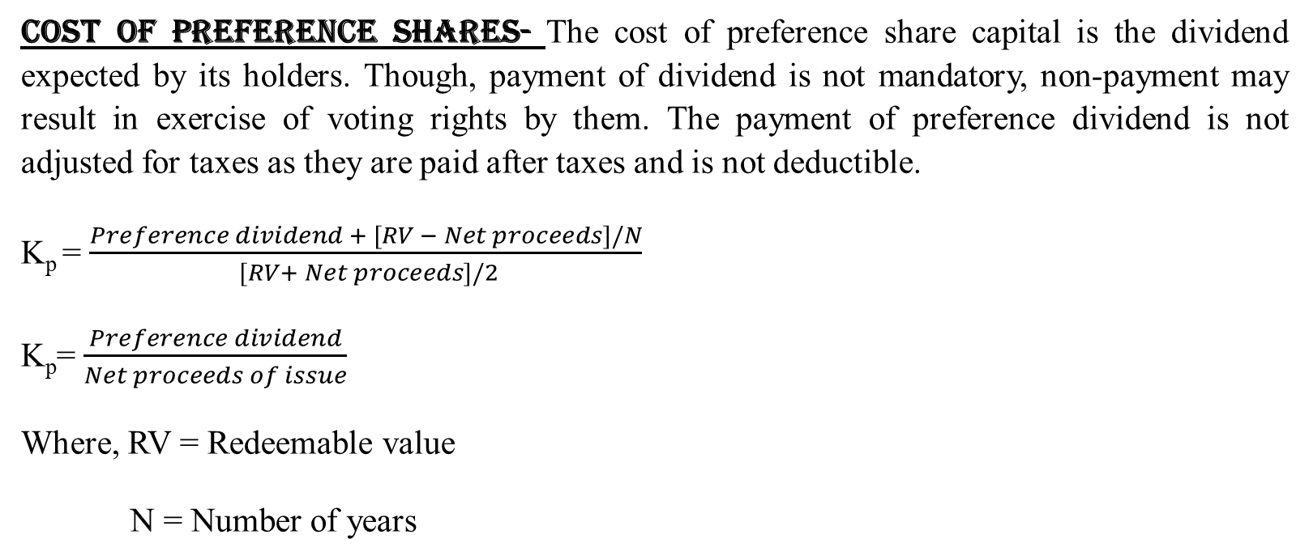
Cost of Preference Shares- The cost of preference share capital is the dividend expected by its holders. Though, payment of dividend is not mandatory, non-payment may result in exercise of voting rights by them. The payment of preference dividend is not adjusted for taxes as they are paid after taxes and is not deductible.
K_{p} = $\frac{Preference dividend + [RV − Net proceeds]/N}{ [RV+ Net proceeds]/2}$
K_{p}=$\frac{Preference dividend}{Net proceeds of issue}$
Where, RV = Redeemable value
N = Number of years
Redeemable Preference shares
Irredeemable Prefence shares

Slide 3
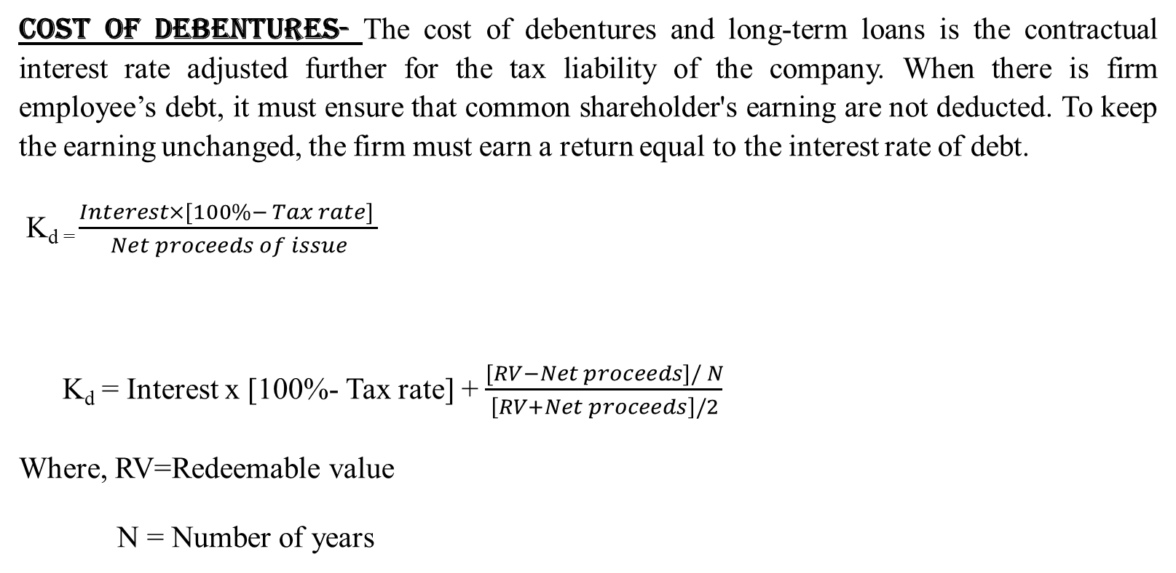
Computation of Cost of Capital
Cost of Debentures- The cost of debentures and long-term loans is the contractual interest rate adjusted further for the tax liability of the company. When there is firm employee’s debt, it must ensure that common shareholder's earning are not deducted. To keep the earning unchanged, the firm must earn a return equal to the interest rate of debt.
K_{d =}$\frac{Interest×[100\%− Tax rate] }{Net proceeds of issue}$
K_{d} = Interest x [100%- Tax rate] +$\frac{[RV−Net proceeds]/ N}{\left[RV+Net proceeds\right]/2}$
Where, RV=Redeemable value
N = Number of years
Irredeemable Debentures
Redeemable Debenture

Slide 5
Weighted Average Cost of Capital (WACC) - A firm obtains capital from various sources. Due to the risk differences and the contractual agreements between the entity and investor, the cost of capital of each source of capital differs. The cost of capital of each source of capital is known as component or specific cost of capital. The combined cost of all sources of capital is called overall or average cost of capital. The component costs are combined according to the weight of each component capital to obtain the average cost of capital. Thus, the overall cost is also called the Weighted Average Cost of Capital (WACC).

Slide 6
CIMA London defines weighted average cost of capital as, "the average cost of company's finance weighted according to the proportion of each element bears to the total pool of capital, weighting is usually based on market, valuations current yields and cost after tax."

Slide 7
The computation of the weighted average cost of capital involves the following steps
Calculate the cost of specific sources of funds e.g. K_{d}, K_{e}, K_{p}, K_{r}.
Assign weights to specific costs.
Multiply the cost of each of the source by the appropriate weights.
Compute the total weighted cost by adding the total of steps.
Hence, weighted average cost of capital
= Sum of [Cost of individual components x Proportion in capital]

Slide 8
THANK YOU

